Slide 1
Parent Portal Registration
Get Registered Today!
1. Click on the PARENT PORTAL link on the left side
2. Click on the button that says FIRST TIME USER ACTIVATION (if needed, otherwise, click existing user link)
3. Enter your ACTIVATION CODE (contact your school to obtain one if needed). We know it’s long - that helps keep the data secure - so type carefully. Once the code has been activated, it can’t be used again.
4. Follow the prompts to set up your username/password and to add a recovery email address.
5. If you’ve forgotten your username/password, click on EXISTING USER in the Portal, then click FORGOT USERNAME/PASSWORD, and the information will be sent to the email used to set up the account. If you no longer have access to the email you used when setting up the account, please send a picture ID to parentportalaccess@columbus.k12.oh.us .
The Parent Portal login will also allow you to have personalized alerts sent directly to your smartphone through the Columbus City Schools Mobile App. You can download the free Columbus City Schools Mobile App now by searching “Columbus City Schools” in the app store on your mobile device.

Slide 2
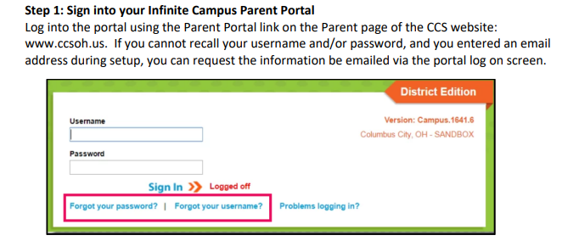
Attendance on Parent Portal

Slide 3
Attendance on Parent Portal

Slide 4
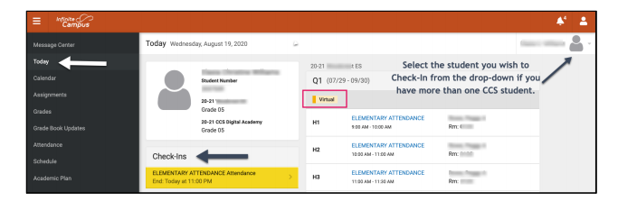
Attendance on Parent Portal

Slide 5
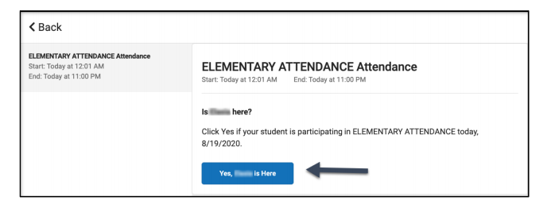
Attendance on Parent Portal

Slide 6
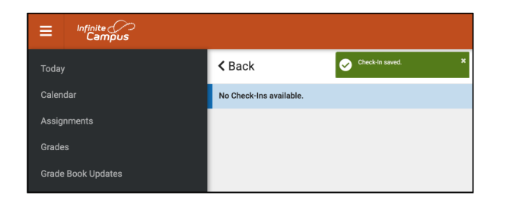
Attendance on Parent Portal

Slide 7
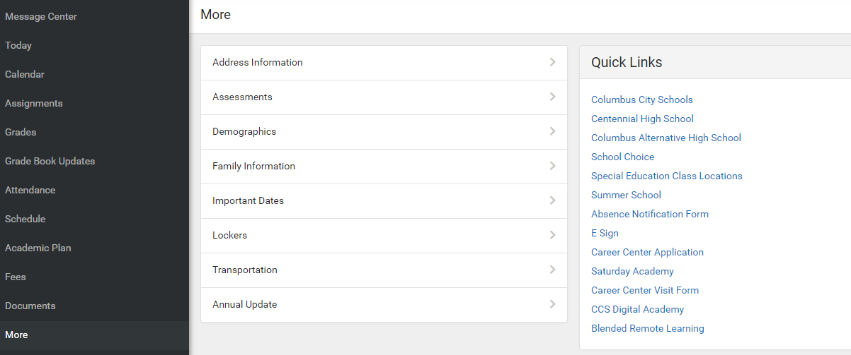
Updating Telephone and Email
on Parent Portal

Slide 8
Updating Telephone and Email
on Parent Portal

Slide 9
Updating Telephone and Email
on Parent Portal

